Slide 1

D. Y. Patil College of Engineering Akurdi, Pune
Presentation for BE Mini Project
Performing tests on Blood bank Management System using Selenium
Guide:
Mr. Pramod Deshmukh
Students Name:
Vikas Mane (B1921152)
Abhijeet Bhalekar(B1921155)

Slide 2
Index
Introduction
Problem Statement and Objectives
Methodology
Result
References

Slide 3
Introduction
The testing of a software product is one of the significant phases of Software Development Life cycle (SDLC). The testing process aims at finding the faults in the source code which might lead to bugs in the functionality of the software. Testing increases the quality of the software. A log containing all the details of the results obtained in the testing process is maintained.
Selenium Web Driver is a programming interface to create and run test cases. It provides a way to act on various web elements.
Why should I use Selenium ??
Open-source
Large support from the community and the user base is huge
Cross-browser compatibility (Firefox, Chrome, Edge etc.,)
Multiple programming language support (Python, Java, Perl etc.,)
Distributed Testing is also supported.

Slide 4
Problem statement
Check the functionality of Blood Bank Management System website using Selenium web-automation tool

Slide 5
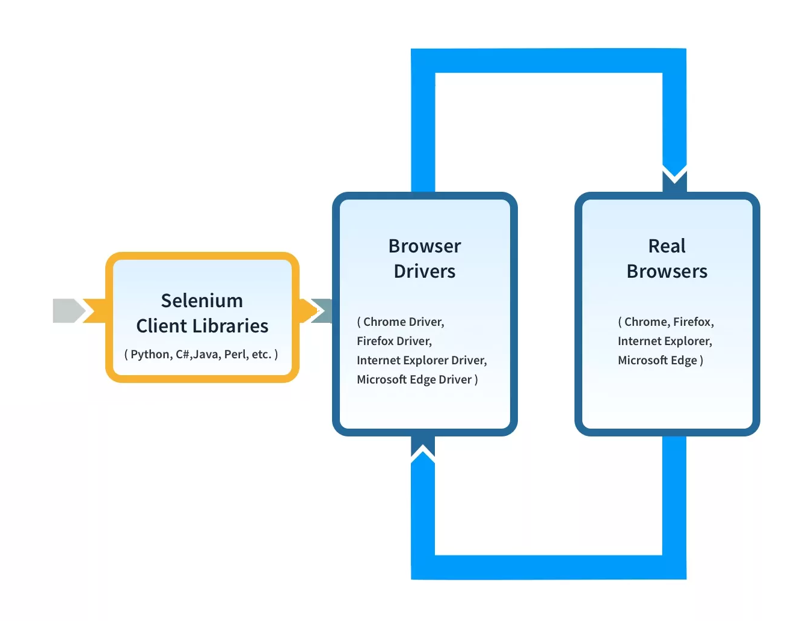
Methodology

Slide 6
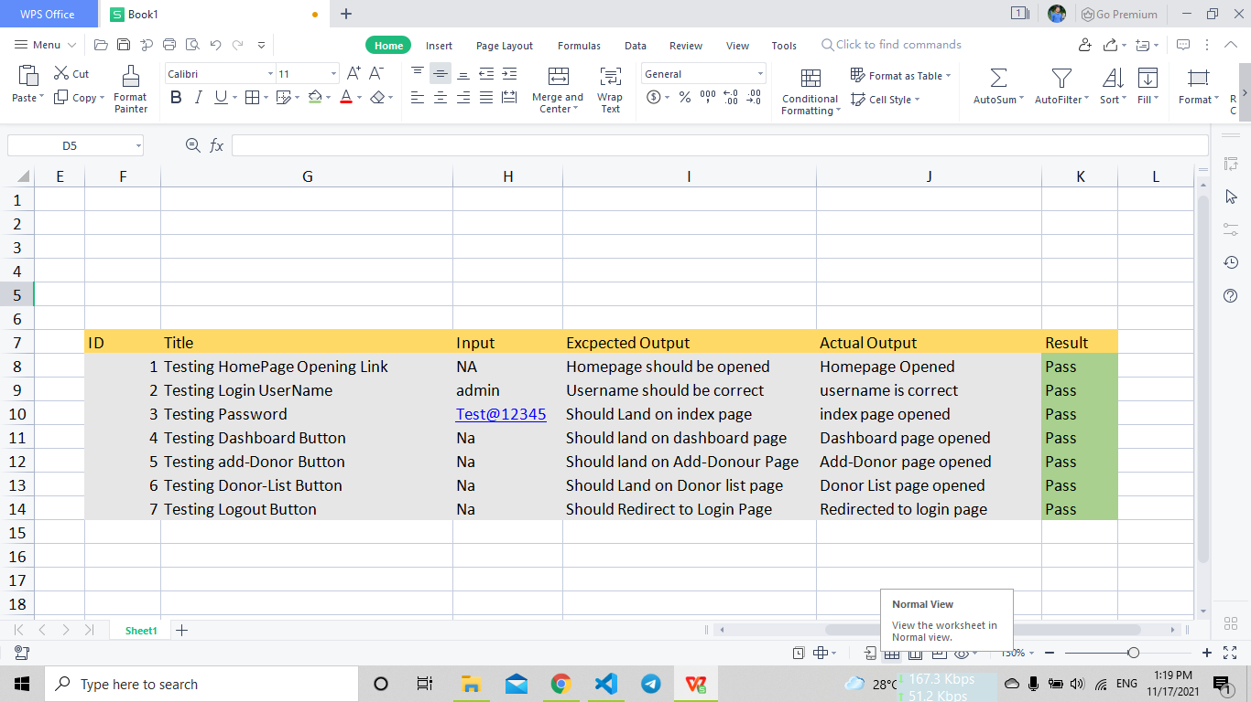
Test Report Summery

Slide 7
References
FitNesse (Web Site: http://www.fitnesse.org)
Selenium, (Web Site: http://www.openqa.org/selenium)
Selenium Frequently Asked Questions, (Web Site: http://wiki.openqa.org/display/SEL/FAQ)
Testing using Selenium Web Driver Paruchuri Ramya, Asst Professor , P Vidya Sagar, Asso. Professor Dept.of Information Technology VR Siddhartha Engineering College Vijayawada, India, 2015
http://www.codeproject.com/Tips/351122/What-issoftware-testing-What-are-the-different-types
http://www.softwaretestinghelp.com/types-ofsoftware-testing/

Slide 8
Thank You!!

